Slide 1
CSE7302 - INTERNSHIP Review-3 Presentation
Project Title: MediCare Plus - University ERP System Domain: Full Stack Web Development
Student Details
Name | HARSHITH V
Roll No | 20221CSE0635
Section | 8CSE12
Under the Supervision of,
Mr. H Senthil Kumar
Associate Professor
Presidency School of CSE
Presidency University
Name of the Program: B-Tech CSE
Name of the HOD: Dr. Asif Mohammed
Name of the Program Internship Coordinator: Mr. Sakthi S
Name of the School Internship Coordinator: Dr. Md Ziaur Rahman

Slide 2
Content
About Company or Organization
Working domain or the technology
About your team and reporting Manager
Challenges Faced in Internship
Objectives of the work
Literature Review
Proposed System
Problem Statement
System Requirements
Advantages of Proposed System/Work
System Design
System Implementation
Internship Roadmap
Github Link

Slide 3
About Company or Organization
Company / Organization Name: Rail Wheel Factory (RWF)
Organization Type: Government of India Enterprise(Under Ministry of Railways)
Location: Yelahanka, Bengaluru, Karnataka
Overview: Rail Wheel Factory (RWF) is a premier manufacturing unit of Indian Railways, established to manufacture cast steel wheels and axles used in railway rolling stock across India.

Slide 4
Working domain or the technology
Internship Domain: Full Stack Web Development
Technologies Used:
Frontend: HTML, CSS, TypeScript
Backend: Python, Flask (REST API Architecture)
Database: Microsoft SQL Server
Tools: VS Code, Postman, GitHub
The project follows a Three-Tier Architecture (Frontend → Backend → Database).

Slide 5
About your team and reporting Manager
• Internship carried out under organizational supervision
Reporting Manager: Mr. Buddha Appa Rao, Senior Section Engineer (SSE) at Rail Wheel Factory.
• Regular progress reviews
• Independent project-based development
My Responsibilities:
• Database schema design
• Writing SQL queries
• Developing Flask APIs
• Frontend integration
• Authentication system implementation
• Debugging and testing

Slide 6
Challenges Faced in Internship
• Designing normalized relational database
• Creating proper primary and foreign key relationships
• Handling SQL join operations
• Debugging Flask–SQL Server connection errors
• Managing session-based authentication
• Fixing frontend-backend API integration issues
Learning Outcome:
• Improved problem-solving skills
• Strong understanding of REST API architecture
• Better debugging and system design knowledge

Slide 7
Objectives of the work
Digitize hospital workflows: patient registration, visits, diagnoses & prescriptions
Implement role-based access for Doctors, Patients, Pharmacists and Admins
Enable real-time prescription tracking and one-click pharmacy dispensing
Allow patients to securely upload and view their own medical files
Provide an admin dashboard with live stats and bulk patient import (Excel/CSV)
Ensure data persistence — no records lost on schema re-deployment

Slide 8
Literature Review
Existing HMS tools (Epic, Meditech) are expensive, desktop-bound and complex to deploy
Most open-source alternatives lack role-based access and modern UI
No unified view across doctor, pharmacist and admin roles in a single application
File upload and bulk import features are rarely included in reviewed systems
Schema migrations in existing tools routinely destroy live patient data
Flask + JWT and React + TypeScript identified as best fit for a secure, modern stack

Slide 9
Proposed System / Work
Web-based Hospital Management System accessible from any browser — no installation
Four role-specific dashboards: Doctor, Patient, Pharmacist, Administrator
Built with React 18 + TypeScript (frontend) and Python Flask REST API (backend)
SQL Server database with stored procedures and views for complex queries
JWT authentication with 8-hour token expiry and SHA-256 password hashing
Supports file uploads (X-Ray, MRI, CT, Blood Test, Reports) up to 50 MB

Slide 10
Problem Statement
Patient records, prescriptions and diagnoses are stored in disconnected silos
Manual, paper-based pharmacy logs cause dispensing errors and no audit trail
Generic systems provide no role separation — privacy risk and cluttered UI for all staff
SQL scripts using DROP TABLE destroy all patient data on every re-run
No mechanism for patients to access or upload their own medical documents
Administrators have no way to bulk-import or track patient registration history

Slide 11
System Requirements
Hardware:
Processor: Intel Core i5 or higher
RAM: Minimum 8 GB
Storage: 10 GB free space
Network: Local or internet access
Software:
OS: Windows 10/11 or Ubuntu 22+
Backend: Python 3.10+, Flask, pyodbc
Database: MS SQL Server 2019+
Frontend: Node.js 18+, React 18, TypeScript
Browser: Chrome, Edge or Firefox (modern)

Slide 12
Advantages of Proposed System
Single platform serves all roles — no need for separate tools per department
IF NOT EXISTS guards prevent data loss during schema updates or re-deployments
Secure by design: JWT expiry, hashed passwords, role-guarded API endpoints
Every prescription, visit and file is timestamped and attributed for full audit trail
Admins can import hundreds of patients via Excel/CSV in one operation
Responsive dark-themed UI works on desktop and mobile without a separate app

Slide 13
System Design
Three-layer architecture: Presentation → Application → Data
Presentation: React + TypeScript with role-conditional navigation
Application: Flask REST API with 15+ endpoints and JWT middleware
Data: SQL Server with stored procedures, views, and IDENTITY primary keys
Core tables: Patients, Users, Doctors, Visits, Diagnoses, Prescriptions, MedicalFiles
Dashboard powered by view vw_DashboardStats for live aggregated counts

Slide 14
System Implementation (At least 50%)
Phase 1 – Database: Schema created with IF NOT EXISTS guards; stored procedures
written for all major queries
Phase 2 – Backend: Flask API built with login_required decorator, JWT stored on flask.g,
dual-mode password verification
Phase 3 – Frontend: Role-based views in single App.tsx; token decoded client-side; inline
form errors; CSS animations
Phase 4 – Testing: All 4 role login flows verified; prescription dispense, file upload/
download and CSV import tested end-to-end

Slide 15
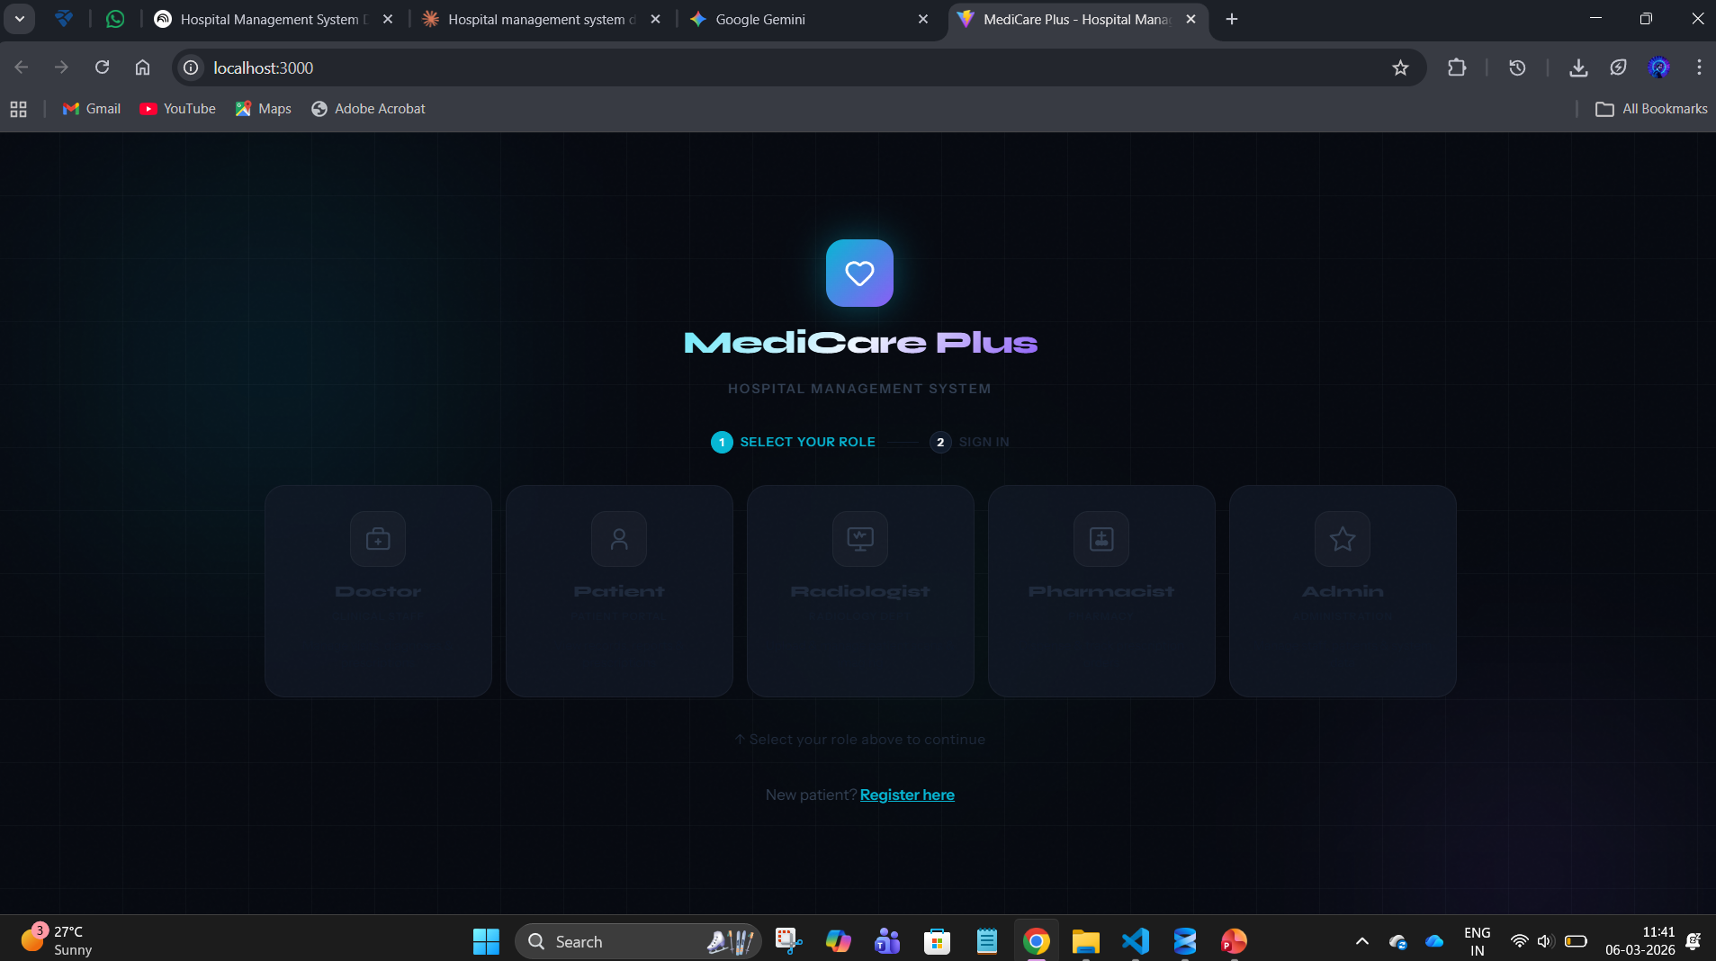
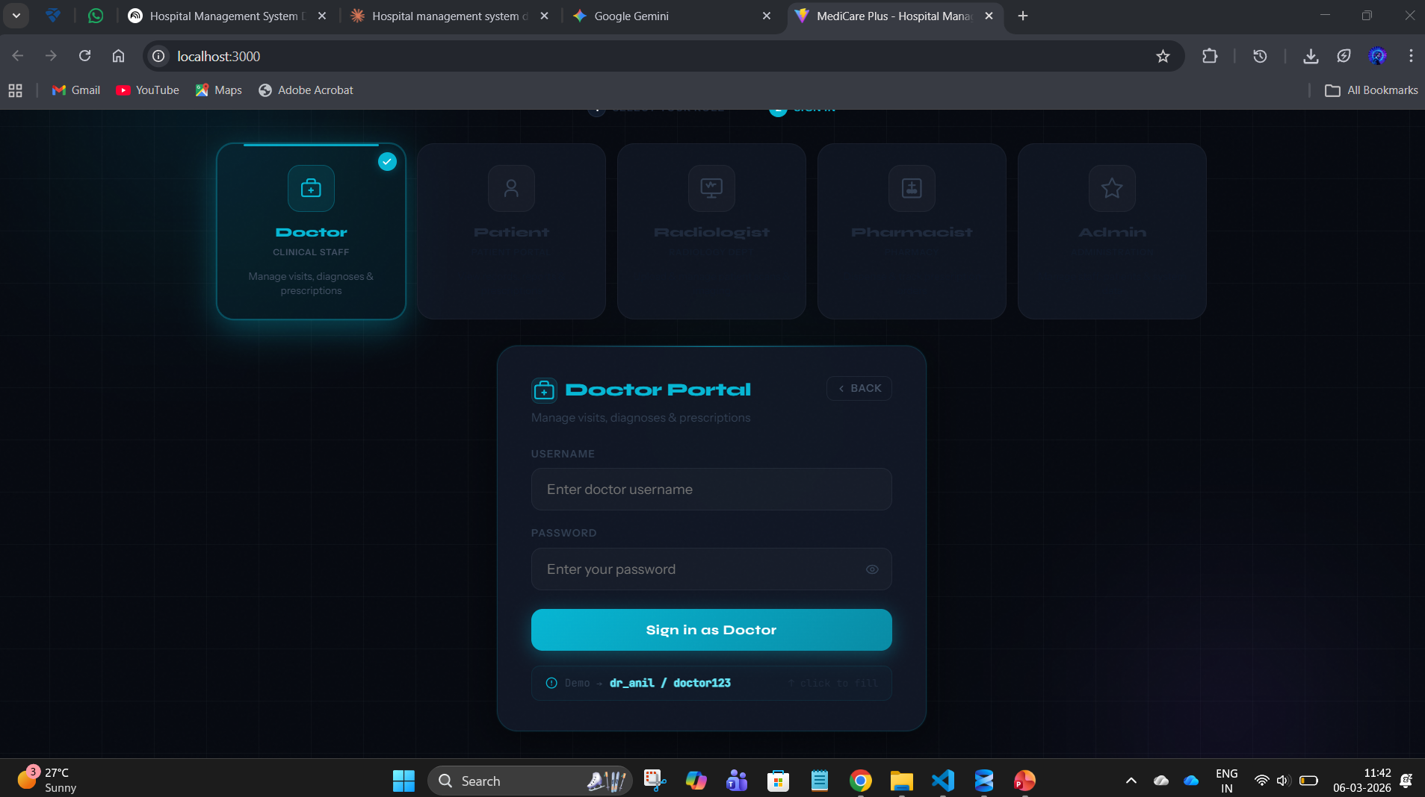
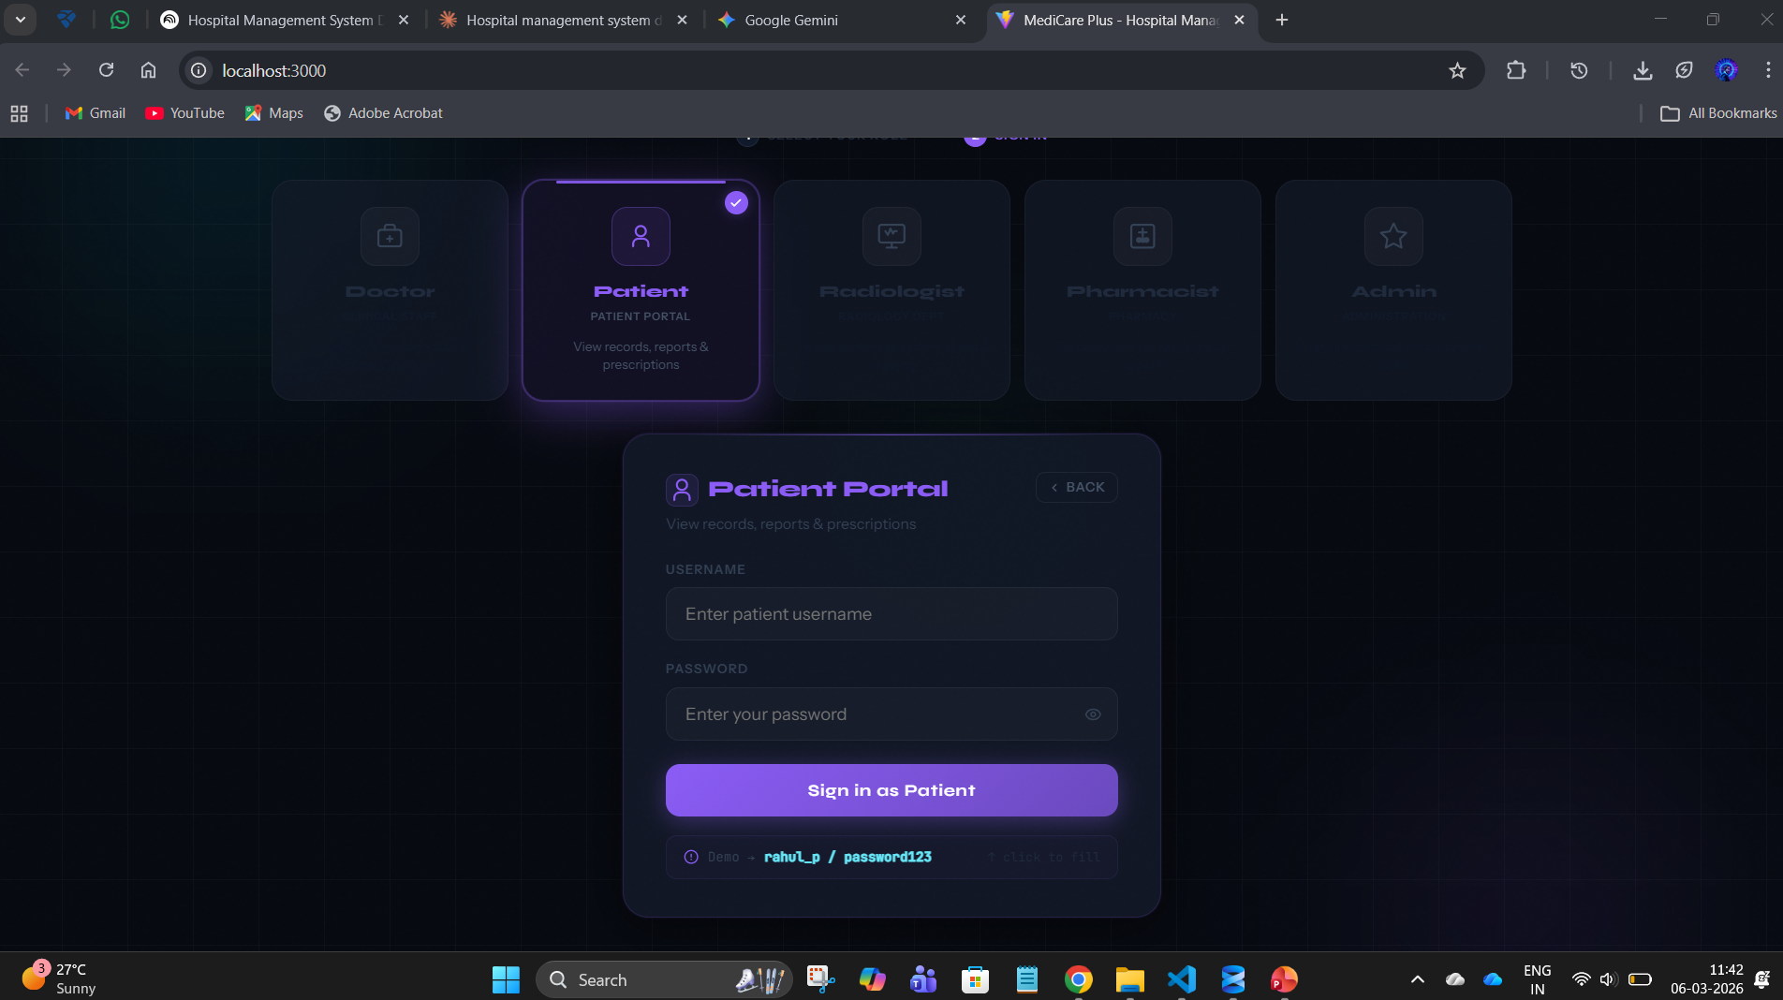
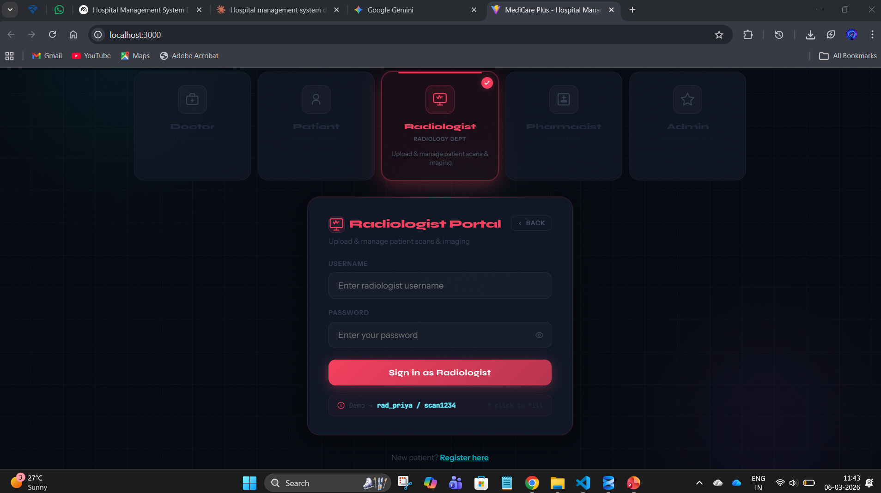

Slide 16
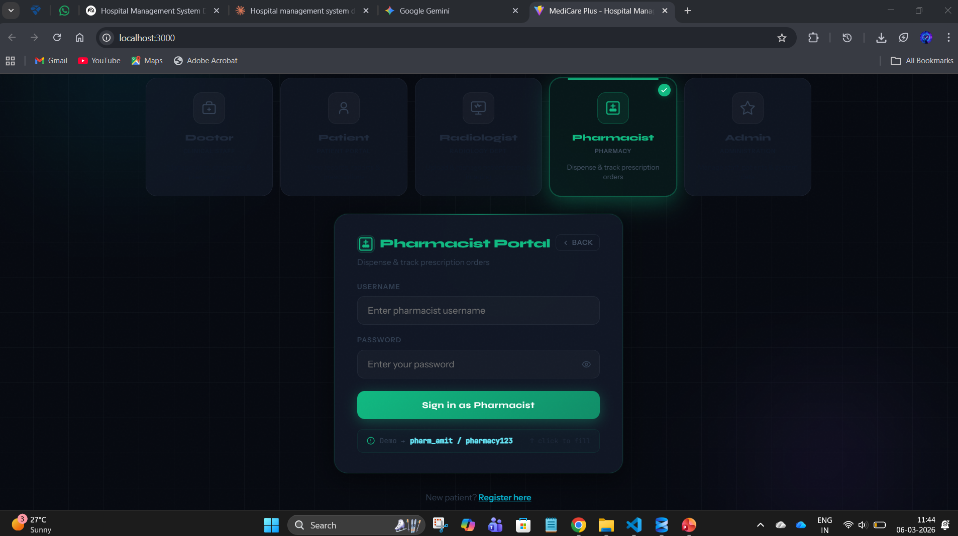
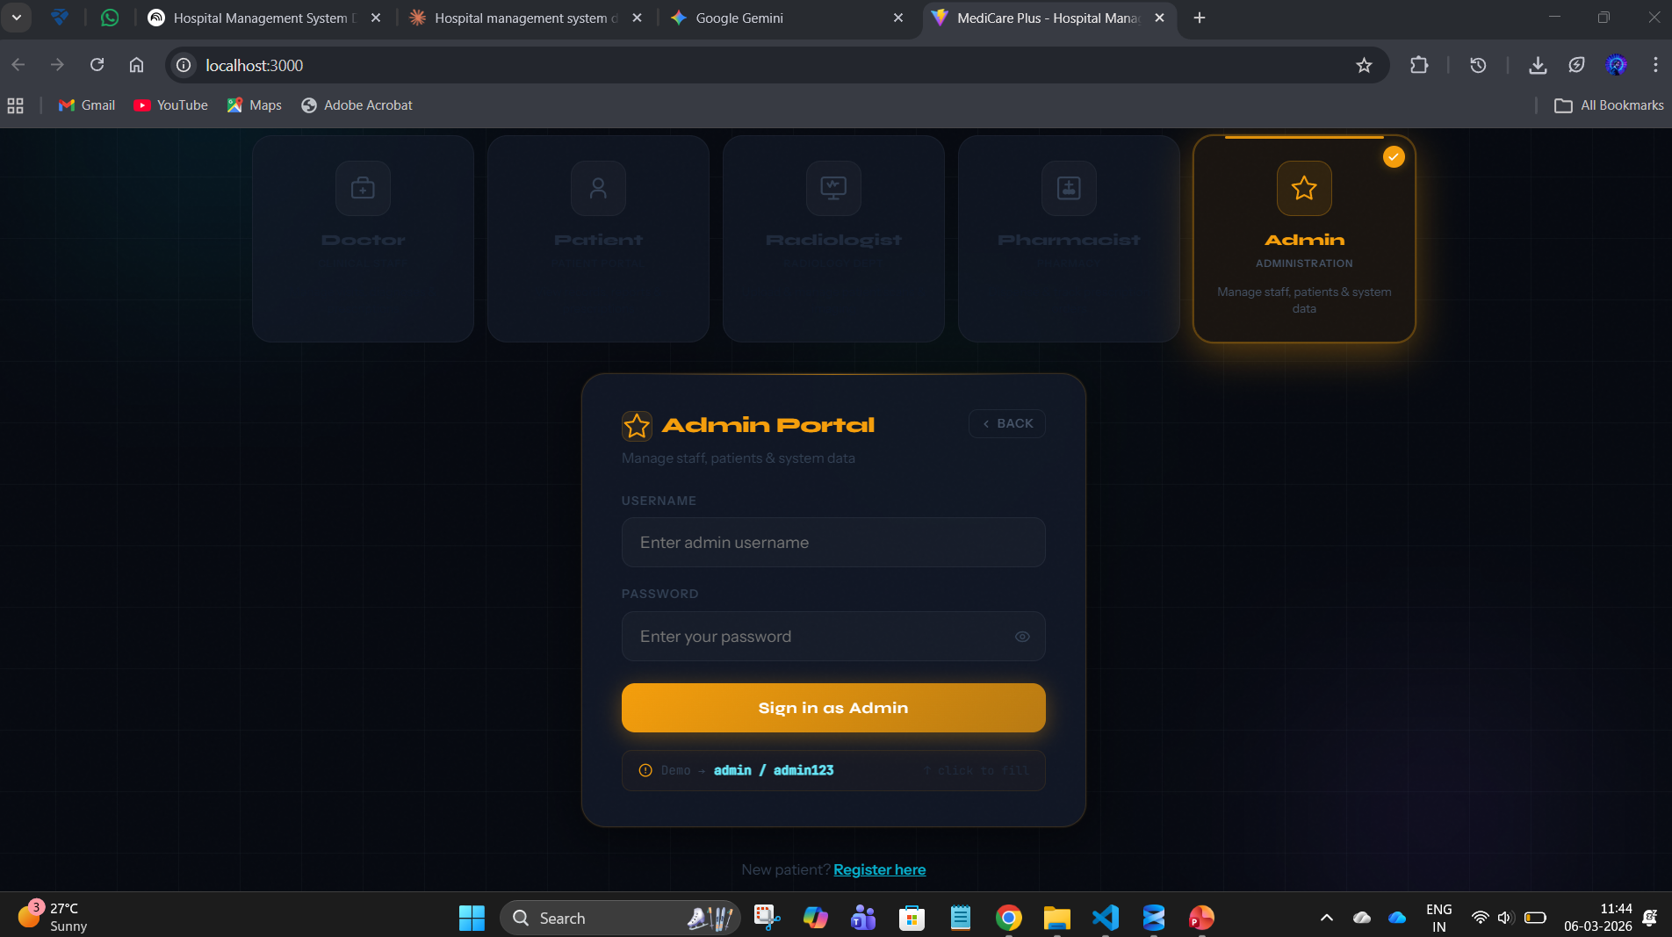
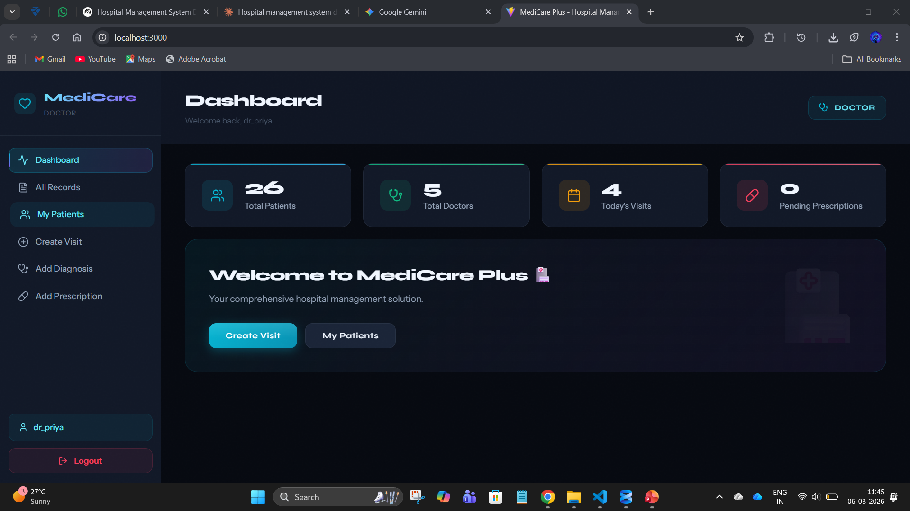
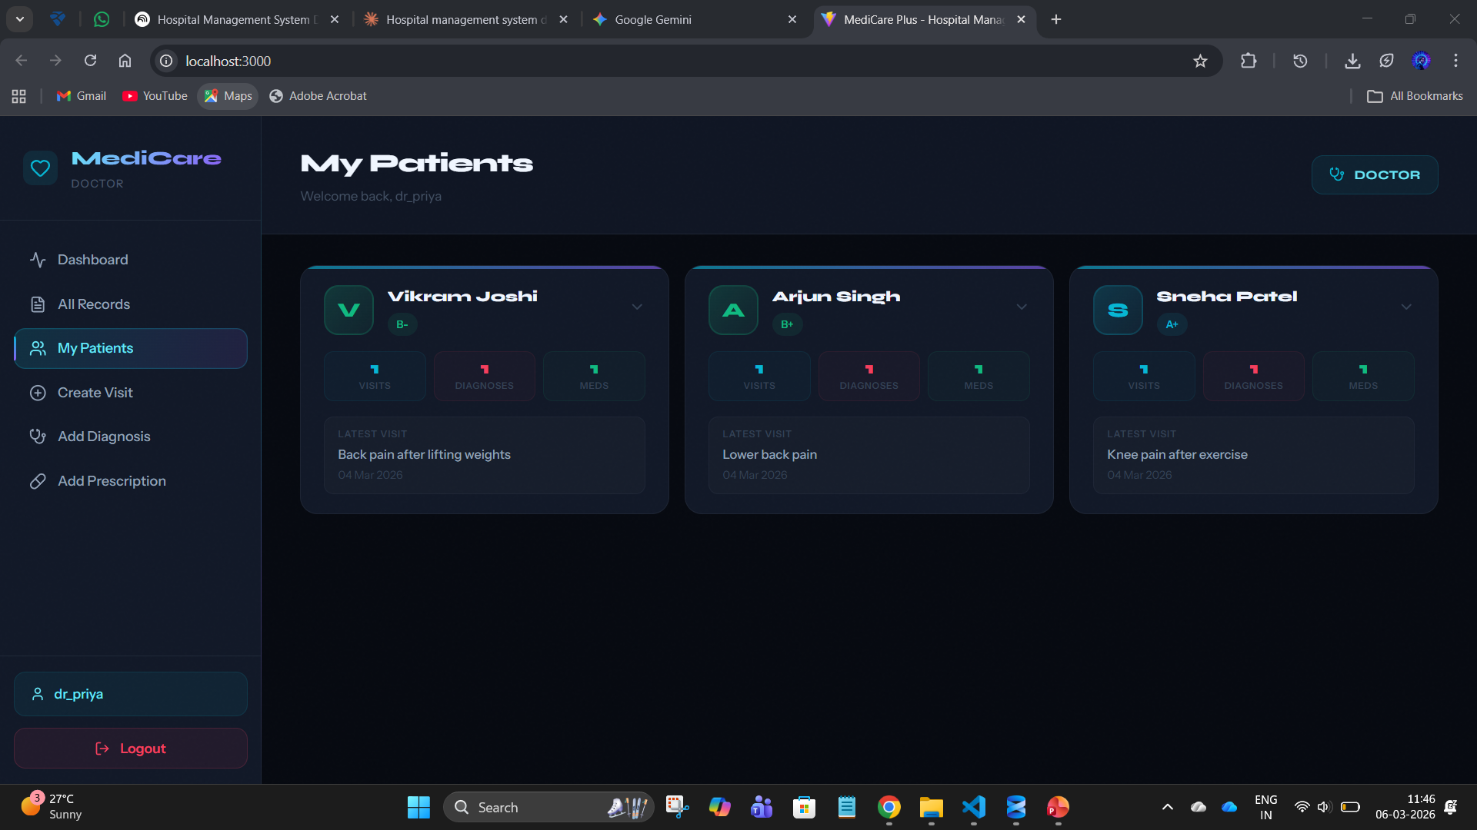

Slide 17
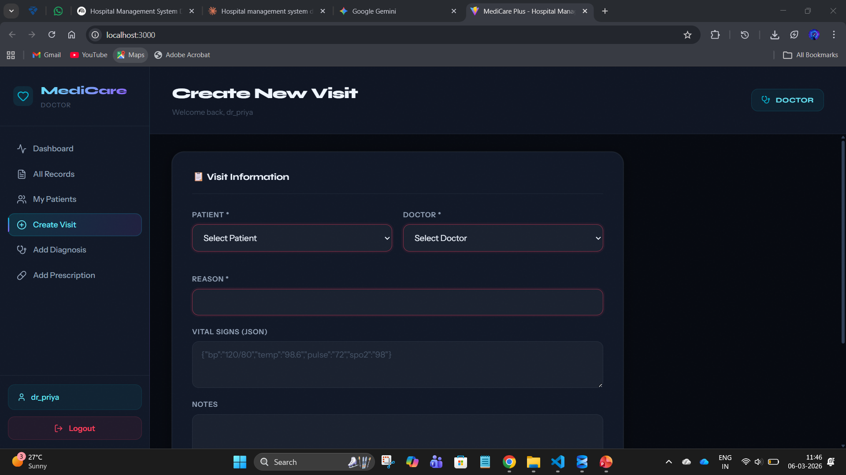
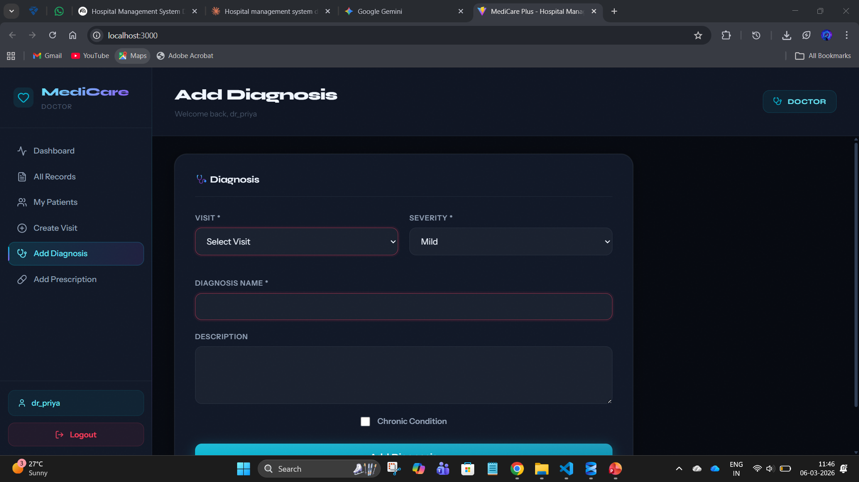
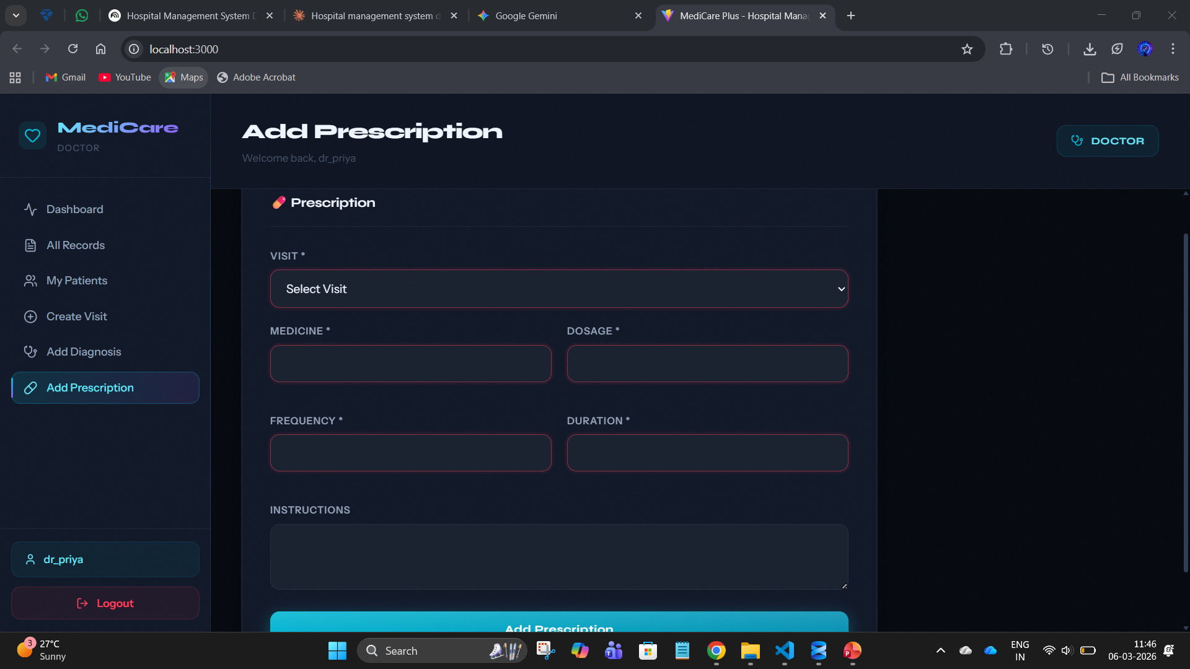
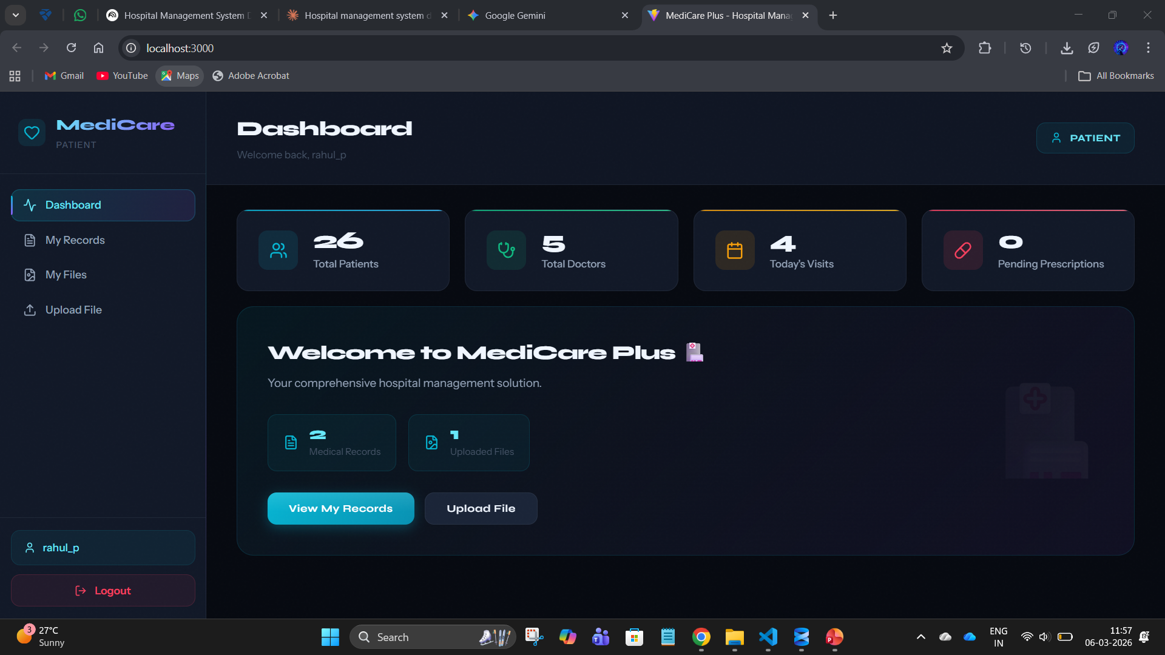

Slide 18
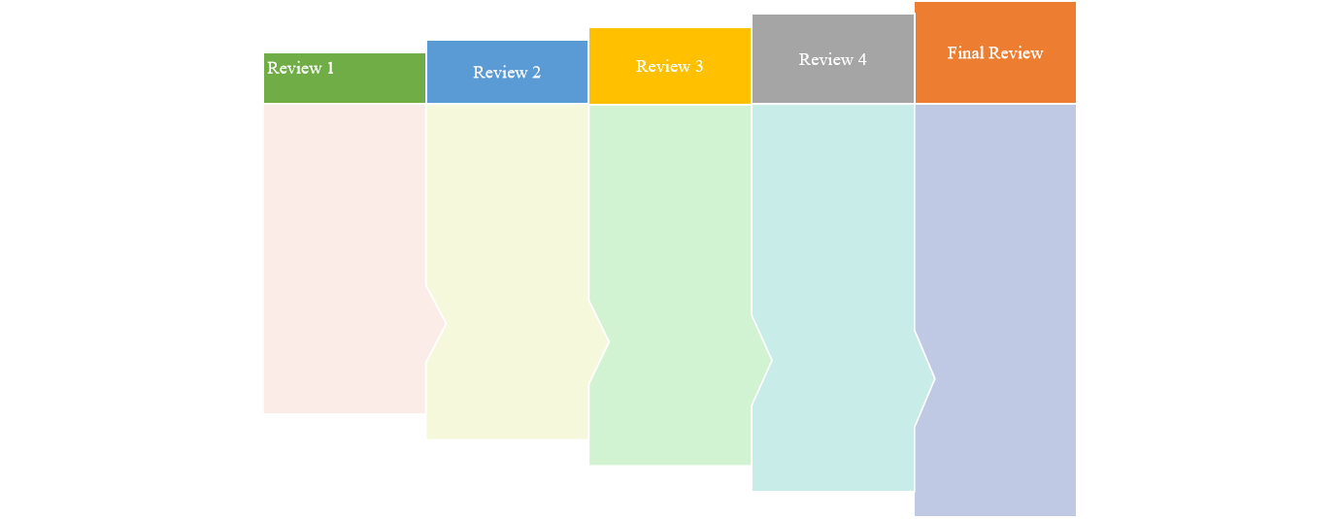
Internship Road Map
10/1/2026-16/1/2026
OVER VIEW OF WHAT WILL BE DONE.
31/01/2026-06/02/2026
THE DESIGN AND DEMO OF THE BACKEND DATA RETRIVAL.
28/02/2026-
06/03/2026
FULLY FUNTIONAL FRONTEND.
03/04/2026-09/04/2026
WORKING MODEL OF THE SAME.
20/04/2026-26/04/2026

Slide 19
Github Link
https://github.com/meharshithv14-ctrl/INTERNSHIP

Slide 20
Q&A

Slide 21
Thank you !!

